Slide 1
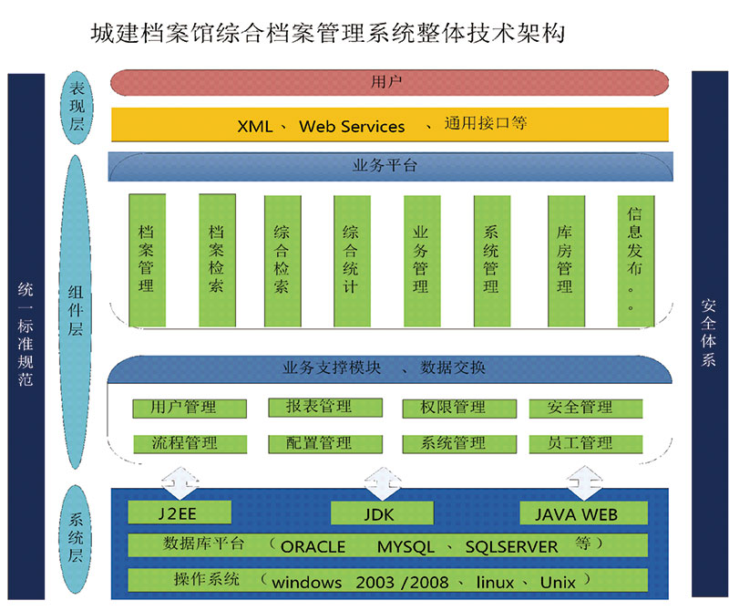
1.1 Systems’ Complexity (I)

Slide 2
Outline
Systems and Complexity
Source of Complexity
Suggested Reading
  Cha 1.1, 1.2

Slide 3
Problem types
Emergent properties
  Surprises
Propagation of effects
  Small change -> big effect
Incommensurate scaling
  Design for small model may not scale
Trade-offs
  Waterbed effect

Slide 4
Emergent property
No evident in the individual components of a system
But show up when combining those components
  might also be called surprises
Focus on unalterable fact of life:
  some things turn up only when a system is built

Slide 5
Emergent property
The Millennium Bridge for pedestrians over the River Thames in London
  Its designers were surprised to discover that
    Pedestrians synchronize their footsteps when the bridge sways, causing it to sway even more
  It had to be closed after only a few days

Slide 6
Propagation of effects (L. Cole 1969)
A tree falling in Oregon--- light off in New Mexico
  When designing a system: Limit the impact of failures
WHO attempted to control malaria in North Borneo
Sprayed villages with DDT
Wiped out mosquitoes, but ….
  Roaches collected DDT in tissue
  Lizards ate roaches and became slower
  Easy target for cats
  Cats didn’t deal with DDT well and died
  Forest rats moved into villages
  Rats carried the bacillus for the plague
WHO replaced malaria with the plague

Slide 7
Incommensurate scaling
As a system increases in size or speed, not all parts of it follow the same scaling rules
  so things stop working.
The mathematical description
  Different parts of the system exhibit different orders of growth

Slide 8
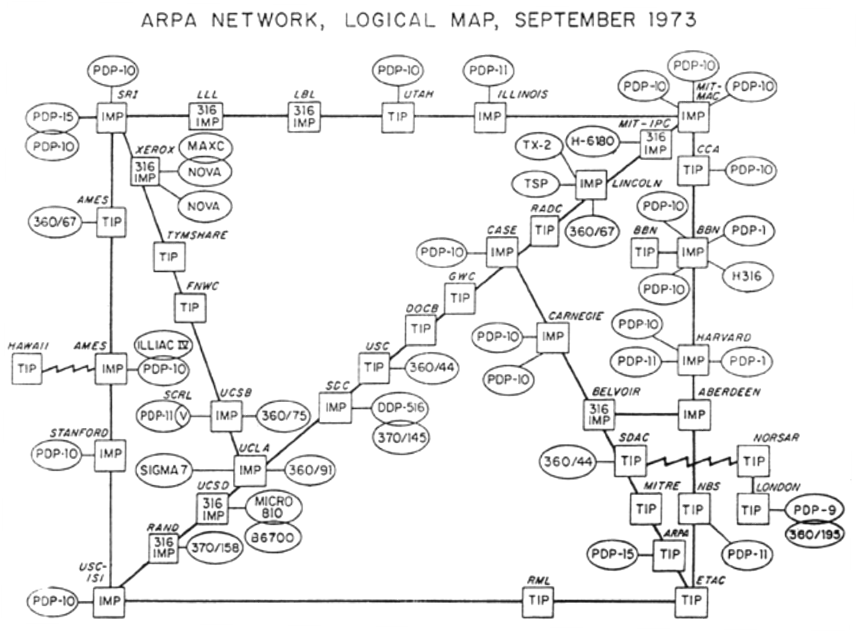
Incommensurate scaling

Slide 9
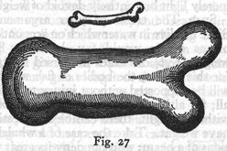
Galileo in 1638
To illustrate briefly, I have sketched a bone whose natural length has been increased three times and whose thickness has been multiplied until, for a correspondingly large animal, it would perform the same function which the small bone performs for its small animal. From the figures here shown you can see how out of proportion the enlarged bone appears.

Slide 10
Galileo in 1638
Clearly then if one wishes to maintain in a great giant the same proportion of limb as that found in an ordinary man he must either find a harder and stronger material for making the bones, or he must admit a diminution of strength in comparison with men of medium stature; for if his height be increased inordinately he will fall and be crushed under his own weight.

Slide 11
Galileo in 1638
Whereas, if the size of a body be diminished, the strength of that body is not diminished in the same proportion; indeed the smaller the body the greater its relative strength. Thus a small dog could probably carry on his back two or three dogs of his own size; but I believe that a horse could not carry even one of his own size.
[Dialog Concerning Two New Sciences, 2nd Day]

Slide 12
Trade-offs
General model
  Limited amount of goodness
  Maximize the goodness
  Avoid wasting
  Allocate where helps most
Waterbed effect:
  pushing down on a problem at one point
  causes another problem to pop up somewhere else

Slide 13
Trade-offs
Binary classification
  we wish to classify a set of things into two categories
    based on presence or absence of some property
  but we lack a direct measure of that property
  so we identify instead some indirect measure
    known as a proxy

Slide 14
Trade-offs
Binary classification
  Occasionally this scheme misclassifies something.
  By adjusting parameters of the proxy
  The designer may be able to
    reduce one class of mistakes
    at the cost of increasing some other class of mistakes

Slide 15
How to handle
How to handle
  emergent properties
  propagation of effects
  incommensurate scaling
  trade-offs

Slide 16
How to handle
Ideally, we would like to describe a constructive theory
Allows the designer systematically to
  synthesize a system from its specifications
  and make necessary trade-offs with precision
There are constructive theories in old fields
  communications systems
  linear control systems
  (to a certain extent) the design of bridges and skyscrapers

Slide 17
How to handle
Unfortunately, in the case of computer systems, we find that we were apparently born too soon.
While our early arrival on the scene offers the challenge to develop the missing theory, the problem is quickly apparent
  we work almost entirely by analyzing ad hoc examples rather than by synthesizing.
  So, in place of a well-organized theory, we use case studies.

Slide 18
1.1.2
Systems, components, interfaces, environments

Slide 19
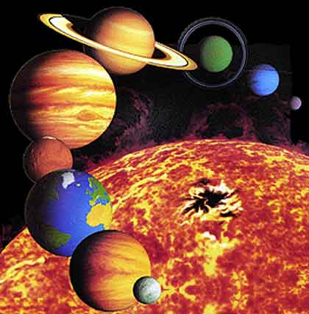

Systems, components, interfaces, environments
Terminology: Systems, components,
interfaces, environments
Notes:
System: Solar system
Environments: the universe
Components: planets and the sun
Interfaces: gravitational attraction and exchange of electromagnetic radiation
System: computer system
Environment: the air, table, everything else
Components: display, mouse, keyboard, box
Interface: mouse, keyboard, display, atmospheric pressure, temperature…

Slide 20
Example: different views of an aircraft
 | as a flying object | as a passenger-handling system
Components | body, wings, control surface, engines | seats, flight attendants, air condition system, gallery
Environments | atmosphere, the earth | the set of passengers
Interfaces | gravity, engine thrust, air drag | the softness of the seats, the meals, the air flowing from the air conditioning

Slide 21
Different purposes and granularities
Different purposes
  e.g. consider engine as a source of noise
  e.g. ignore the control surfaces on the wings
Different granularities
  System and subsystem are relative
  e.g. engine is a component of aircraft, while itself is a system

Slide 22
Complexity signs
Webster’s definition: “difficult to understand”
Signs of complexity (like diagnosis in medicine)
  Large number of components
  Large number of interconnections
  Many irregularities
  A long description
  A team of designers, implementers, or maintainers
Notes:
Using signs instead of measurement, is borrowed from medicine.

Slide 23
Example of signs of complexity
Large university library VS. small town library
  More catalogs: aids, guides, journal indexes, etc.
  More cross-references
  More exception: oversized books over newspaper rack, microfilm or digital media, etc.
  No methodical rules for locating a piece of information ( for small library how to design)
  More personnel and even specialists
Notes:
Unanimity is not essential, but only one or two of the signs may not make a compelling case for complexity

Slide 24
Levels of complexity
All system are indefinitely
  The deeper one digs, the more signs of complexity turn up
  A computer -> gates -> electrons -> quarks -> …
Abstraction: limits the depth of digging

Slide 25
1.2 Sources of complexity

Slide 26
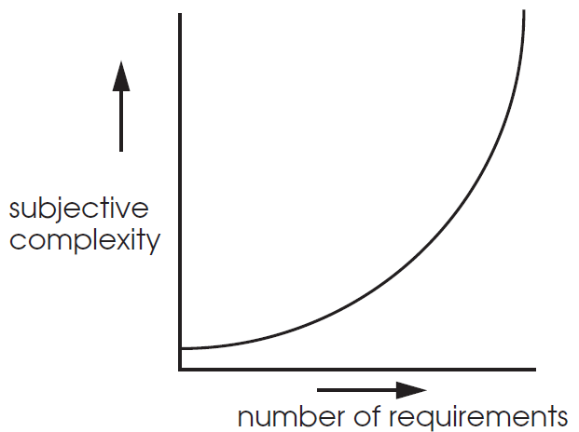
1.2 Sources of complexity
Many goals/requirements
Interactions among requirements

Slide 27
Example: more goals, more complexity
1975 Unix kernel: 10,500 lines of code
2008 Linux 2.6.24 line counts:
  85,000 processes
  430,000 sound drivers
  490,000 network protocols
  710,000 file systems
  1,000,000 different CPU architectures
  4,000,000 drivers------for lots of goals, /generality
  7,800,000 Total

Slide 28
Interacting features
An interaction is bad if feature X breaks feature Y
  The point is not that these bad interactions can’t be fixed
  The point is that there are so many interactions that have to be considered: they are a huge source of complexity
  Perhaps more than n^2 interactions

Slide 29
Example: interacting features, more complexity
Call Forwarding
Call Number Delivery Blocking
Call 900 (reverse billing)
A blocks outgoing call to 900
A call B, B forwarding to 900
What happens?

Slide 30
Principles
Principles of escalating（升级） complexity
Adding a requirement increases complexity out of proportion
  The complexity barrier is soft: no warning
  Requirements increasing leads exceptions increasing

Slide 31
Principles
Avoid excessive generality
If it is good for everything, it is good for nothing
Generality
  Meeting many requirements with a single design
  General enough to minimize the number of exceptions
  But…….

Slide 32
Principles
A single design for many circumstances ---→trade off --→complexity
    E.g. design a vehicle that can drive on the highway, fly, use as a boat
  Unwanted generality → a user suppress generality -→ I can’t use other guy’s computer or cell phone

Slide 33
Effect of incommensurate scaling
Insects absorb oxygen through skins VS. Larger one uses lungs
? One pc could solve a math problem, can we build a 10000 times powerful machine of PC’s architecture ?

Slide 34
Requirements change
To meet the new environment
To Update the system
Propagation of effects amplify problems caused by the change
Updating may cause incommensurate scaling effects
Introducing bugs

Slide 35
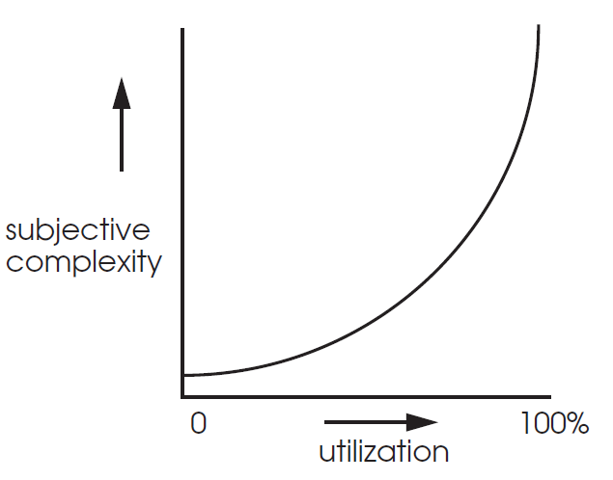
Maintaining High Utilization

Slide 36
Example: single rail
Performance -> complexity
Base design: alternate trains
  Low throughput, high delay
  Worse than two-track, cheaper than blasting
Lower delay w/ a siding and two trains
  Precise schedule
  Risk of collision / signal lights
  Siding limits train length (a global effect!)
Point: performance cost super-linear

Slide 37
Principles
The law of diminishing returns（边际递减）
The more one improves some measure of goodness, the more effort the next improvement will require

